Slide 1


Anno Accademico 2022 – 2023
Software Architecture
Alexandru Nicolae Andrei 829570 Giacomo Savazzi 845372 Andrea Assirelli 820149
November 29, 2022

Slide 2
Anno Accademico 2022 – 2023
In Depth Study - Security
If you reveal your secrets to the winds, you should not blame the wind for revealing them to the trees.
- Kahlil Gibran

Slide 3
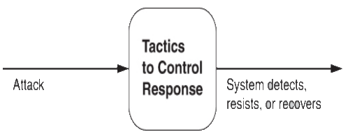
Anno Accademico 2022 – 2023
Tactics for Security

Slide 4

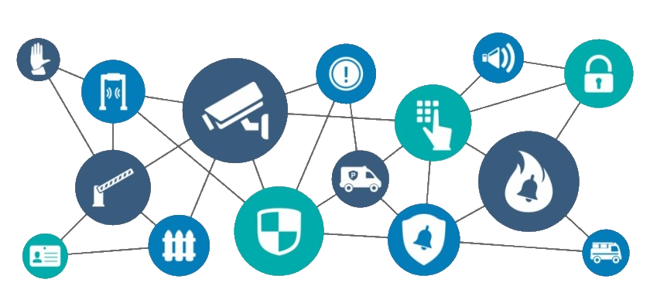
First Step – Physical Security
Limited access (e.g., fences and security checkpoint);
Detecting intruders (e.g., visitors with badges);
Deterrence mechanisms (e.g., armed guards);
Reaction mechanisms (e.g., doors automatic lock, acoustic alarm);
Recovery mechanisms (e.g., off-site backup);

Slide 5
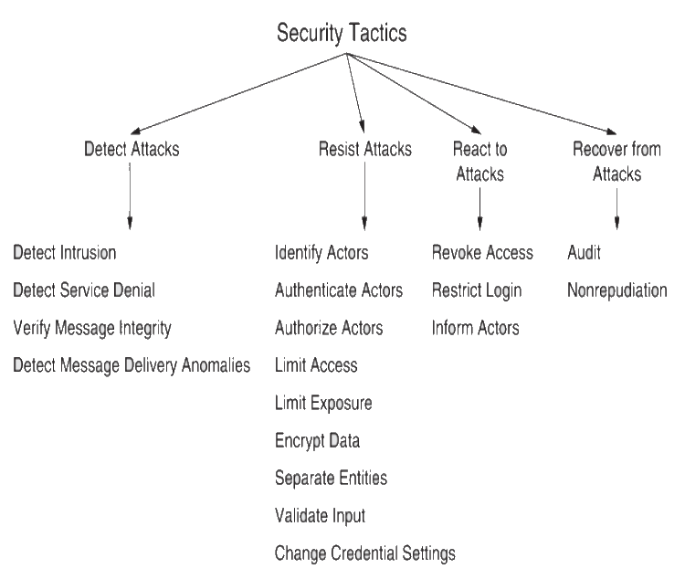
Categories of Tactics
Detect Attacks: identify an attack before it takes effect;
Resist Attacks: prevent possible attack;
React to Attacks: resist to ongoing attacks;
Recover for Attacks: restore system after a successful attack;

Slide 6

Categories of Tactics – Detect Attacks
Detect Intrusion: compares network traffic with a set of known malicious patterns, based on payload size, port number, source or destination address etc.;
Verify message Integrity: using of techniques, like checksum or hash value, to verify the integrity of messages, resource file, configuration files etc.;

Slide 7

Categories of Tactics – Resist Attacks
Authenticate Actors: ensuring that an actor is actually who (or what) it purports to be. Techniques to do that are password, OTP, biometric identification etc. Another example is CAPTCHA, a challenge-response test, used to verify if the user is human or not;
Encrypt Data: provide extra protection on confidential data. This is the only useful protection for passing data over public access network;

Slide 8
Thanks for Your Attention

